Slide 1
Impact of information technology on society
Jason holden & Agapitus Iboro

Slide 2

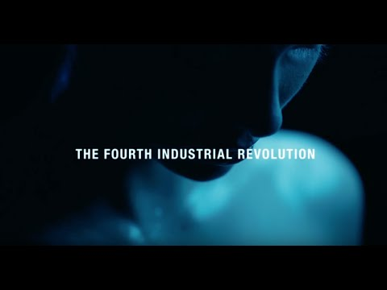
What is the Fourth Industrial Revolution? Ubiquitous, mobile supercomputing. Artificially-intelligent robots. Self-driving cars. Neuro-technological brain enhancements. Genetic editing. The evidence ... youtu.be

Slide 3
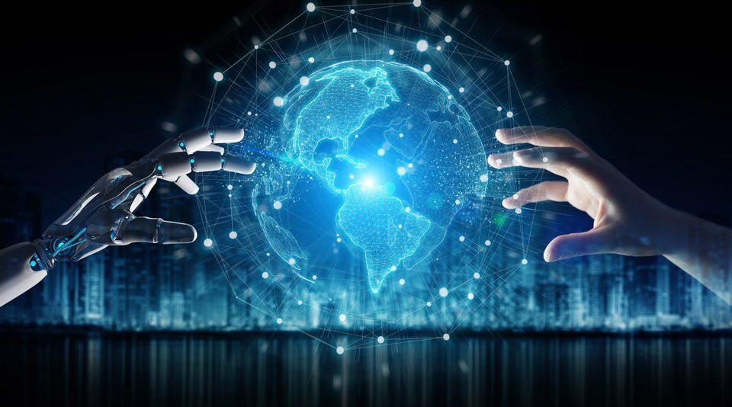
ARTIFICIAL INTELLIGENCE

Slide 4
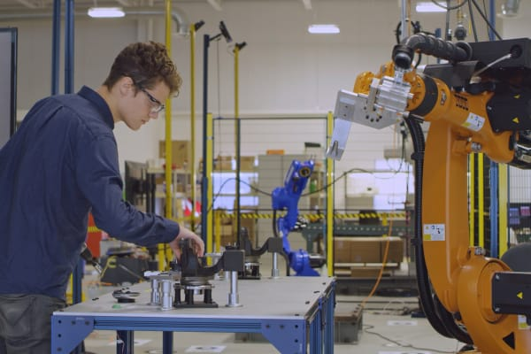
How Veo Robotics is making industrial robots safer - cnbc.com Massachusetts-based startup, Veo Robotics, is using sensor technology and computer vision to make it safe for humans to work alongside large factory robots. One VC firm estimates that the market ... www.cnbc.com

Slide 5
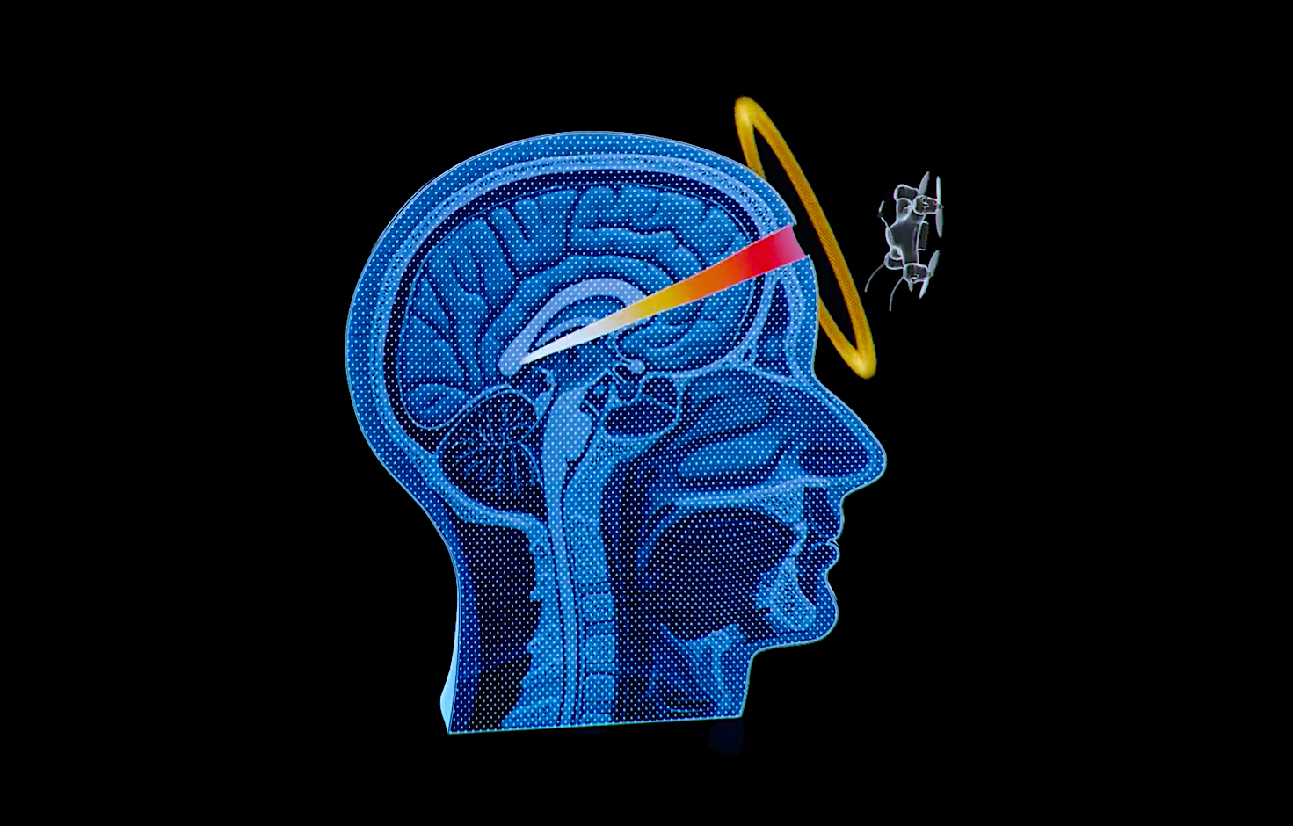
SLAUGHTER BOTS

Slide 6

Broken Records Part 1: How We Got Here I Fortune When the American healthcare system began to transition to Electronic Healthcare Records, policy makers saw a future full of potential and possibility. Subsc... youtu.be

Slide 7
activity
Pro's and Cons to an automated workforce
Ideas on jobs that can or cannot be automated

Slide 8
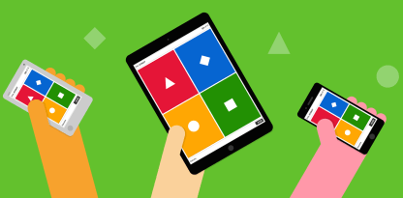
KAHOOT

